Slide 1
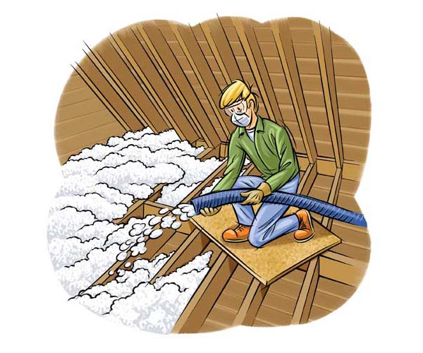
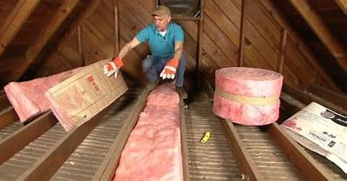
Insulation
Lining the inside of the walls, floors and roof of your house can make sure that heat is not transferred between the outside air and the inside of the house.
Insulation keeps the heat in on a cold day and out on a hot day.
Adding insulation is one of the best ways to increase energy efficiency and make a home comfortable year-round.

Slide 2
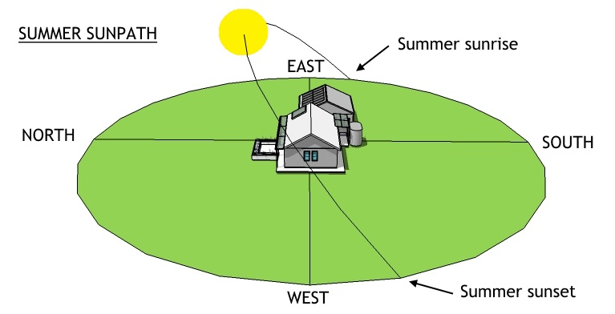
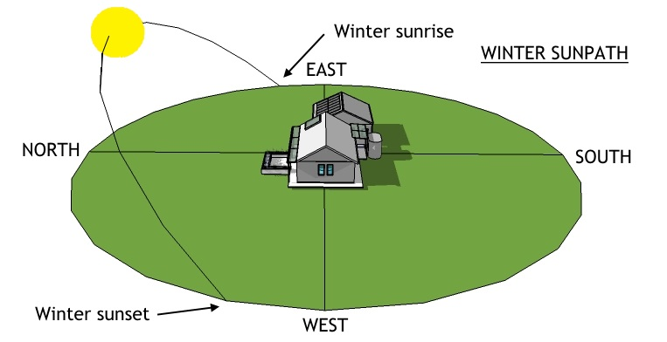
Windows
On a hot day, the light and heat from the sun easily penetrate a window, transferring heat into the house.
Ways to increase home energy efficiency of windows:
Window tinting
Using double glazed glass
Limiting the number of windows facing the summer sunshine and increasing the number of windows facing the winter sunshine.

Slide 3
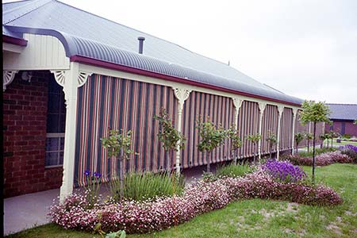
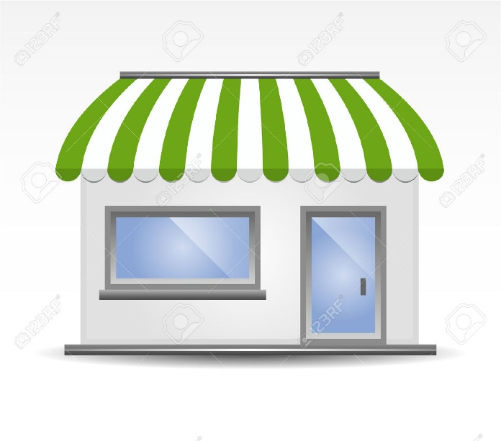
Eaves, Verandas or Pergolas
Eaves, verandas, pergolas and awnings are house coverings.
They prevent heat and light from the sun shining on the walls and windows.
This prevents heat and light being transferred to the walls, and then to the air inside.

Slide 4
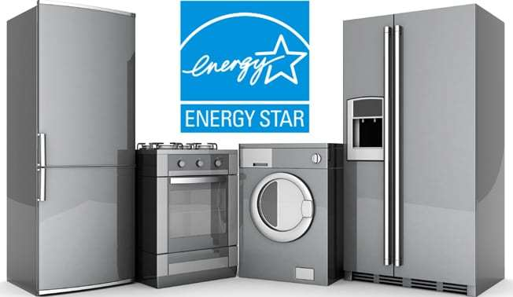

High-Efficiency Appliances
Energy-saving appliances can make a big difference in home energy consumption and bills.
More stars means the appliance is more energy efficient.
Less energy is being wasted (usually as heat and/or sound) making electricity and gas bills cheaper.

Slide 5
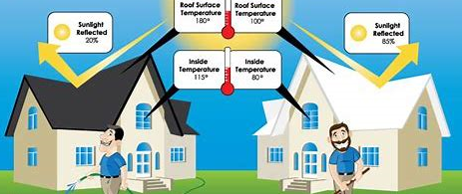
Light-coloured roof
A light-coloured roof or roofs with a reflective coating, reflects more sunlight and absorbs less heat.

Slide 6
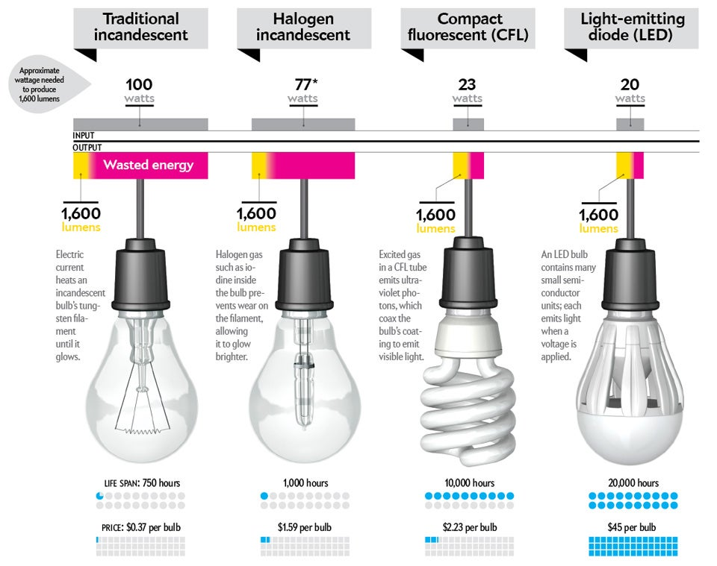
Lighting
Switching out old light bulbs with energy-efficient light bulbs, means significant energy savings over time.
←
Least Efficient
→
Most Efficient

Slide 7
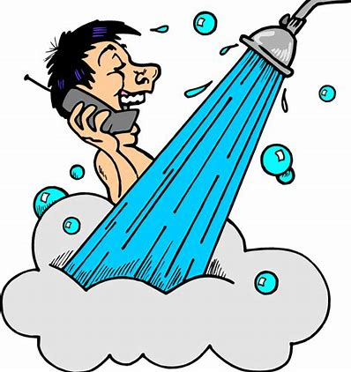
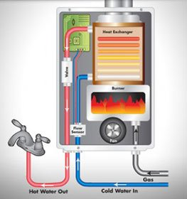
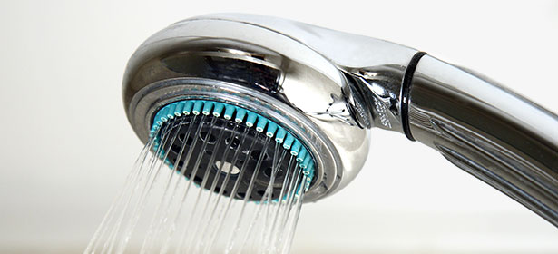
Showerheads
Taking a shower rather than a bath.
Installing low-flow shower heads will save 10,000 L of water per person per year.
Shorten your shower by one minute and save 3,650 L of water per year.
Reducing the amount of water also reduces the amount of energy required to heat the water.

Slide 8
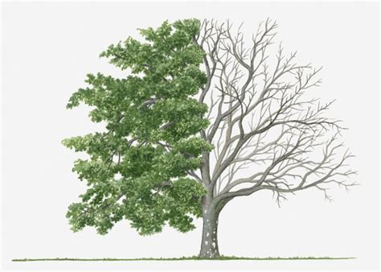
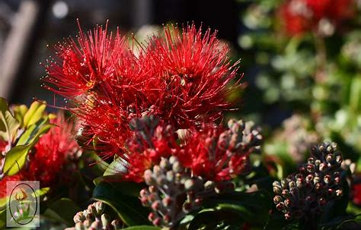
Landscaping
Planting deciduous trees (trees that shed leaves in autumn) on the south and west sides of a home, provides shade in the summer, while allowing warming sun to shine through in the winter.
Plant native vegetation because it requires less water and fertiliser.

Slide 9
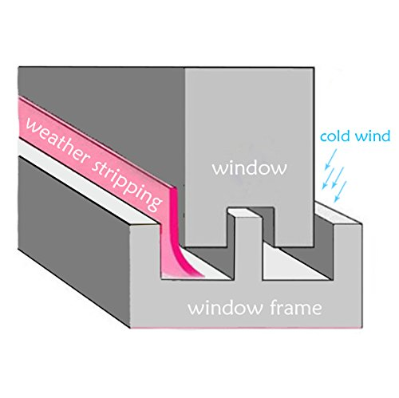
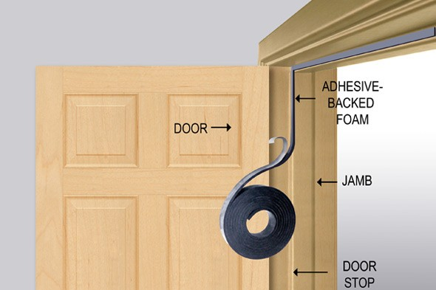
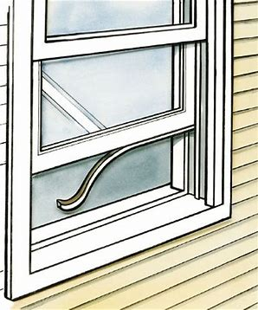
Weather-stripping
Add weather-stripping around doors and windows
Preventing air leaks from windows and doors.
Keeping heat in during the winter and cool air in during the summer.

Slide 10
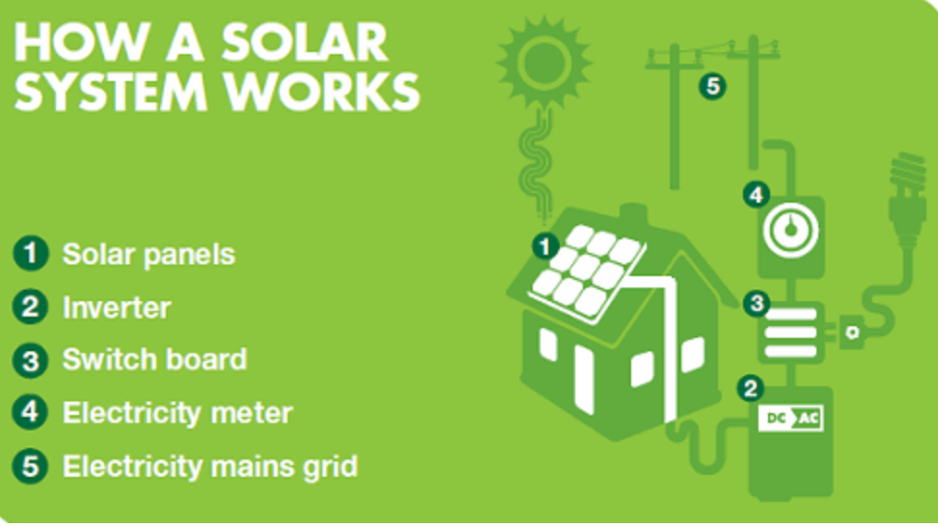
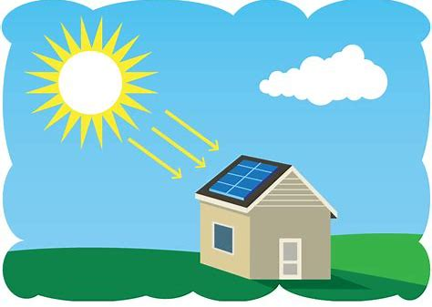
Solar Power
The sun shines on the solar panels, a solar inverter converts the light energy into electrical electricity that can be used to power appliances in your home.
Any power not required by your home can go into the mains power grid for others to use.

Slide 11
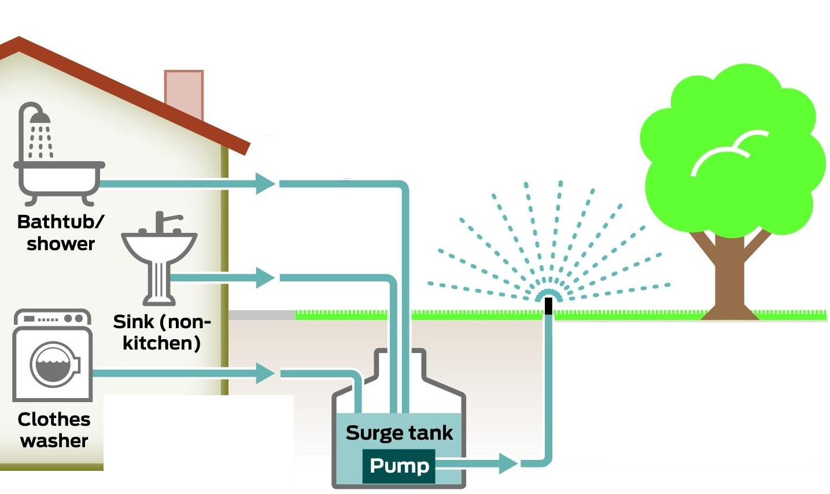
Grey Water Recycling
The used water from bathtubs, washing machines and other household appliances is drained and stored in a tank.
The used water is called grey water.
Water used in kitchens and toilets goes directly into sewers, it is not recycled.
The grey water is used to:
irrigate gardens,
wash cars and
flush toilets.

